Slide 1

MOODY QUERY
Muntadher AlZayer
John Welch
Michael Vienneau
Amanda Tran
Vibhor Mishra

Slide 2




TWITTER STATISTICS
3. UK
18.6m Users
1. US
72.3m Users
2. Japan
50.9m Users
4. KSA
13.8m Users
40% of users are between 18 and 29 years of age
83% of 193 UN States have Twitter Presence
Over 1.3 Billion Total Accounts
330 Million Monthly Active Users
500 Million Tweets per Day

Slide 3

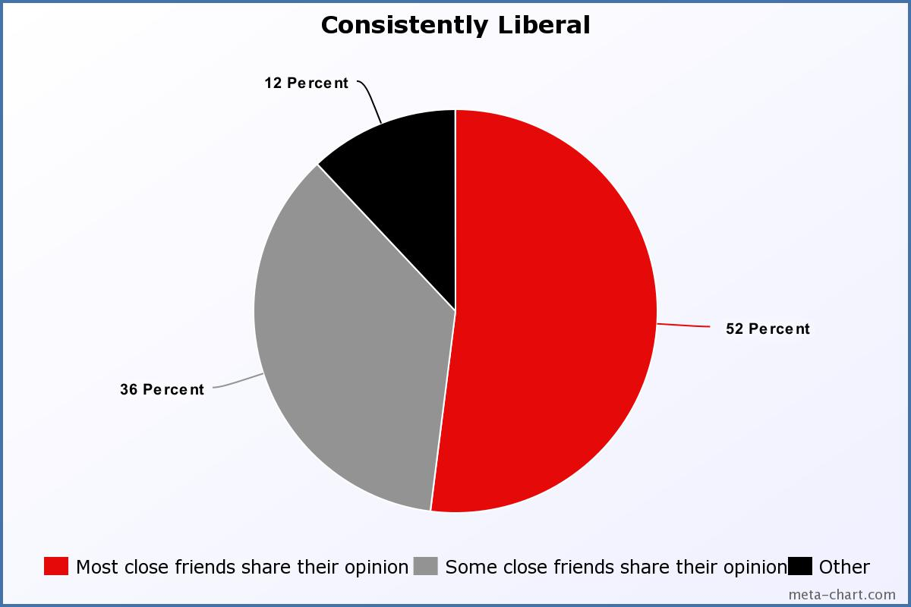
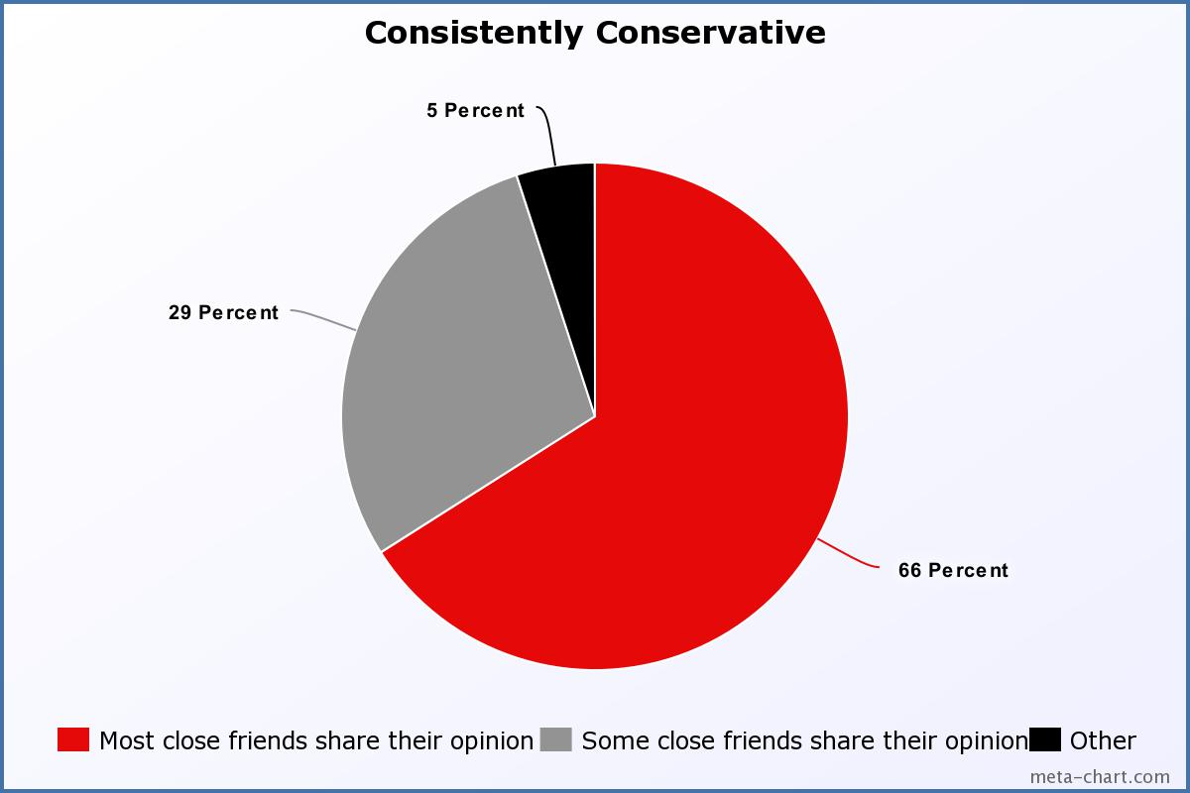
MOODY QUERY
Objective
Political Divide
We surround ourselves with people who share our opinion
Source: http://www.journalism.org/2014/10/21/political-polarization-media-habits/pj_2014-10-21_media-polarization-03/
Create a visualization of opinions around the world based on Twitter Data
Notes:
Objective- We are working on a sentiment analysis of tweets based on predetermined queries and based on new user searches. Our program will output a map of the world showing the sentiment of Twitter users in their respective countries.
From a study done by the Pew Research Center we can see that the majority of people who consistently identify as liberal or conservative surround themselves with people who are like minded and share their views, producing confirmation bias. Our project produces a color coded map of twitter users’ opinions.

Slide 4






SOFTWARE
Enterprise Search retrieves relevant tweets within the past X days
Kinesis sends those tweets in batches to Lambda function
Lambda function runs sentimental analysis in relation to keyword
DynamoDB stores data with partition key: Query term
Library focused on sentiment analysis

Slide 5






Architecture
Batch
Twitter Enterprise API
Kinesis Stream
Lambda Function
DynamoDB
Frontend
Search Term
Lambda Function
Notes:
I am going to make a diagram like in class - Munta
A search term will be queried using Twitter Enterprise API
Tweets are then pushed to kinesis in batches
Sentimental analysis is through the library: Textblob using a lambda function
Outputted data is stored in DynamoDB with the partition key being the query term, and a value for the sentiment
That is then displayed on the world map

Slide 6
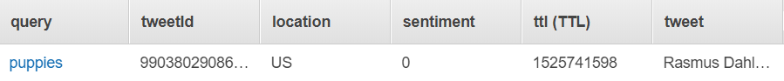
Data in DynamoDB

Slide 7
Live Demo

Slide 8
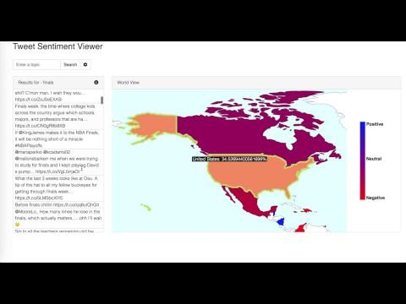
Video Demo

Slide 9

Main Takeaway
Batch writing is almost necessary for Big Data
Twitter is generally very negative as a platform - mainly used for ranting
Sentiment Analysis on social media data tends to be inaccurate (sarcasm, emoji use, limited characters, etc.)
Insight into industry-level software
Notes:
Batch reading and writing is almost necessary for big data
Distributed compute would be a future improvement on overall speed of processing
Twitter is generally very negative -- it is a platform for ranting mainly
Sentiment Analysis on social media data tends to be inaccurate (sarcasim, use of emojis, limited characters, etc)

Slide 10

Future Improvements
Distributed computing would be a future improvement on overall speed of processing
Sentiment Analysis can always be improved
Better design of Frontend display for large amounts of twitter data
Live updating the data on GUI/maps through stream after a new keyword is searched.

